Slide 1

Don’t Rush a 25-Year Mistake, we have better options: Alternatives to RIGS
Dr. Moe Qureshi, Ph.D.
Director of Climate Research and Policy
January 2026

Slide 2




Environmental nonprofit in New Brunswick since 1969
Membership based
New Vision: A healthy, sustainable, just environment in New Brunswick for all
New Mission: The Conservation Council of New Brunswick promotes and advocates for a healthy, shared environment through research, education, and engagement with communities, industry and government

Slide 3





Conservation Council Members’ and Supporters’ Top Concerns - 2024
CLIMATE CHANGE
SUSTAINABLE FOREST MANAGEMENT
HERBICIDE / PESTICIDE USE
BIODIVERSITY LOSS
LACK OF RENEWABLE ENERGY / RELIANCE ON FOSSIL FUELS

Slide 4






What is RIGS? (Renewable Integration & Grid Security)
Project Overview: RIGS = Renewable Integration and Grid Security project. A proposed 400–500 MW electrical generating station near Centre Village (Tantramar).
Technology: It will use eight to ten aeroderivative gas turbines (small jet-engine-based generators) with dual-fuel capability (fracked natural gas as primary fuel, with diesel as backup – fossil fuels).
Fast-Start Peaker: These turbines are “fast-starting” (compared to what?) and are supposed to operate as peaking units – providing power during high demand periods or when other sources (wind/solar) are insufficient.
Grid Support: RIGS also includes grid-stabilizing synchronous condensers (can be built without RIGS) to support voltage and frequency stability.
Timeline & Operator: NB Power has contracted a U.S. firm, ProEnergy, to build, own, and operate RIGS under a 25-year agreement. Target operation start: 2028.
+25 years = 2053
Notes:
-400 MW of firm generating capacity contracted for NB Power use
-Facility is expandable to 500 MW (10 × 50 MW units) if a third-party partnership proceeds
-cold to full power in ~6 minutes
A synchronous condenser is a machine that supports the power grid without producing electricity
It spins like a generator, but is not connected to fuel or power output
Provides:
Voltage control (reactive power support)
System inertia (helps stabilize frequency)
Improved reliability during disturbances or outages
Especially important as wind and solar increase, since they do not naturally provide inertia

Slide 5
Why is NB Power Proposing RIGS Now?
Impending Capacity Shortfall: NB Power’s planning studies identified a generation capacity gap by 2028 – meaning without new resources, they might not meet peak demand around that time. This is accelerated from earlier forecasts (shortfall originally expected in the 2030s, but demand growth moved it up). Maybe due to new data centers?
Retirement of Coal by 2030, Mactaquac Refurbishment, Issues at Lepreau
Reliability & “Energy Security”: NB Power stresses the need for reliable backup power as it adds intermittent renewables. RIGS is presented as an “insurance policy” to keep the lights on when wind/solar can’t. Subject to fuel price volatility.
Replace Aging Oil Units: NB has some old oil-fired peaker units that are expensive and high-emitting. RIGS turbines may displace heavier GHG generators (NB Power says it will reduce use of older oil units).
Fuel Flexibility & Transition Narrative: By being dual-fuel (and possibly hydrogen-capable later), NB Power frames RIGS as a “transitional” asset.

Slide 6



Why the RIGS Diesel / Gas Plant is the Wrong Choice
Health Concerns
Burning gas and diesel creates air pollution that can trigger asthma, heart problems, and lung disease.
Nature at Risk
The site sits on the Chignecto Isthmus, a key wildlife corridor between NB and NS. Clearing land, adding noise, lights, and traffic, and draining wetlands would harm wildlife and raise flood and drought risks.
Water Under Pressure
The plant could use about 7 million litres of groundwater a day, enough to lower wells, dry out wetlands, and harm streams. Wastewater and fuel spills could also threaten drinking water.
Community Concerns
Mi’kmaq communities have raised concerns about how large industrial projects threaten land and water, and say their rights must be respected through free, prior, and informed consent.

Slide 7




Why the RIGS Diesel / Gas Plant is the Wrong Choice
20th Century Technology
Experts say NB Power is choosing old technology. A new gas plant could become outdated fast as clean energy grows. It might not even pay for itself before it becomes useless.
Underuse of the Plant
The plant may only run a few hundred hours a year. That means NB Power would pay for it all year even though it sits idle most of the time. Some say that money would be better spent on storage or energy-saving programs.
Financial Risk
If carbon prices rise or rules get tougher, running a gas plant will get expensive. Meanwhile, wind, solar, and batteries keep getting cheaper, which could make the gas plant a bad investment long before 2050.
Fossil Fuel Lock-In
Building a gas plant now would lock New Brunswick into decades of pollution. Fracked gas isn’t clean or renewable, and methane leaks make climate change worse.

Slide 8
Greenhouse Gas Emissions Expected from RIGS
Construction (2 years)
  Total direct emissions (diesel use + land-clearing/biomass):
  ≈ 21,130 tonnes CO₂e over 24 months (≈ 10,565 t CO₂e per year).
Operation (per year, maximum operating hours)
  ≈ 910,825 t CO₂e per year.
Over the 25-year project life (if it operated every year at that peak-stress level)
  ≈ 22.8 million tonnes CO₂e (this is a straight multiplication based on their own peak-case annual figure).
Decommissioning
  They assume decommissioning emissions similar to construction diesel use only:
  ≈ 17,732 t CO₂e, not counting land-use change
Share of wider emissions
  Proponent’s own comparison: at peak-stress operation, project operation alone would be ~7.9% of New Brunswick’s annual emissions and ~0.1% of Canada’s, based on 2023 inventories.

Slide 9


How Big Is ~0.9 Mt of Emissions Per Year?
Equivalent to ~8% of all annual emissions from New Brunswick.
NB emits ~11–12 Mt CO₂e/year; this project alone would add nearly one-tenth.
Equal to the CO₂ removed annually by ~41 million trees.
One mature tree absorbs ~22 kg CO₂/year; 0.9 Mt would require ~41 million trees.
Over 25 years, the facility could produce ~23 Mt CO₂e,
A cumulative volume comparable to the CO₂ emitted by all passenger vehicles in NB for multiple years.

Slide 10
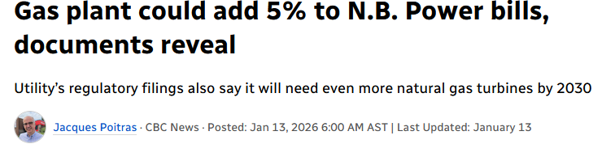
RIGS: An Expensive, Risky Deal for Ratepayers
25-year lock-in: Ratepayers must pay fixed monthly capacity charges for decades, even when the plant barely runs (~5% utilization)
Core prices redacted: Core prices (capacity $/kW-month, escalation rates, penalties) are not available to the public
More expensive than owning: NB Power states the tolling deal costs $49M–$184M more than public ownership over its lifetime
Ratepayers still pay the capital: ~$25M in transmission upgrades plus ~$70M in switchyard assets added to NB Power’s books
Fuel and carbon risk dumped on customers: NB Power buys the gas and fuel oil and absorbs all future price and carbon cost increases

Slide 11
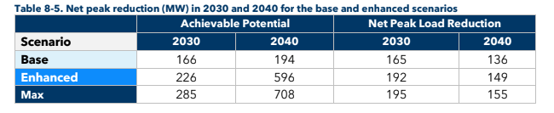
Are there other alternatives to RIGS? - Demand-Side Management
The lowest-cost energy resource: Reducing demand is consistently cheaper than building new generation. Every megawatt avoided saves ratepayers from decades of capital, fuel, and maintenance costs.
Cuts bills immediately and permanently: Energy efficiency and demand response lower monthly bills for households and businesses, especially during winter peaks that drive system costs.
Directly reduces peak demand: DSM targets the exact problem RIGS is meant to solve: short, extreme peak events. Peak shaving avoids expensive infrastructure built for only a few hours per year.
Reduces emissions without new fossil fuel infrastructure: Lower demand means less gas, oil, and coal generation, cutting emissions while supporting climate targets.
Faster to deploy than new power plants: Programs like smart thermostats, load shifting, and efficiency upgrades can be rolled out in months, not years.
Keeps money in New Brunswick: DSM investments support local contractors, installers, and communities instead of sending ratepayer dollars to out-of-province or foreign energy companies.
Improves energy security and resilience: A flexible, responsive grid with active customers is more resilient to extreme weather, fuel supply shocks, and market volatility.
Scalable and adaptable: DSM can grow over time, adjust to real demand trends, and be combined with renewables and storage, unlike a 25-year fossil contract.
Dunsky Energy and Climate, prepared for NB Power: New Brunswick Demand Side Management Potential Study Volume 1 – Results (Final)

Slide 12
Are there other alternatives to RIGS? - Batteries
Battery Energy Storage Systems (BESS) Is Better Than RIGS
⚡ Faster: Batteries respond in milliseconds — gas turbines take minutes
🌱 Cleaner: Almost zero emissions vs. 25+ years of fossil fuel from RIGS
🔁 Flexible: Modular, scalable, and relocatable — unlike fixed gas infrastructure
💰 Cheaper over time: No fuel costs, low maintenance, and falling battery prices
🧠 Smarter: Supports renewables, enables demand response, and grid automation
🇨🇦 Canadian-made: Built by Canadian firms, supporting local jobs and innovation
📈 Future-proof: Aligns with NB’s net-zero 2035 goal — RIGS locks in fossil dependence until 2050+ and risks $1.4Billion stranded asset risk
Bottom line: Batteries do everything RIGS claims to — but faster, cleaner, and with no long-term climate cost.

Slide 13
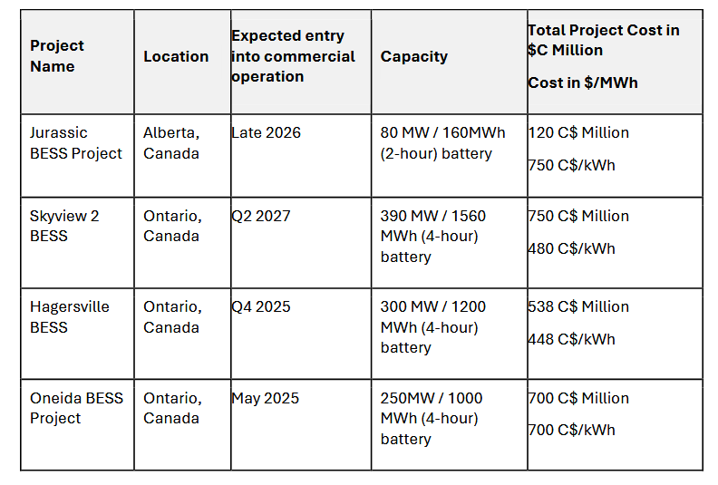
Overview of recent utility-scale BESS projects in Canada
Initially estimated at $800 million in 2023, the total capital cost came in around $700 million upon completion and completed ahead of schedule.
Received financing:
Canadian Infrastructure Bank provided $170 million
Natural Resources Canada provided $50 million through Smart Renewables and Electrification Pathways (SREP program)
Federal Investment Tax Credit: up to 15% of capital cost ($100-120 million) as a refundable credit
Equity Funding from partners
CCNB’s: Expert Evidence in New Brunswick’s Energy and Utilities Board (EUB) Matter EL-002-2025. Written By Toby Couture

Slide 14
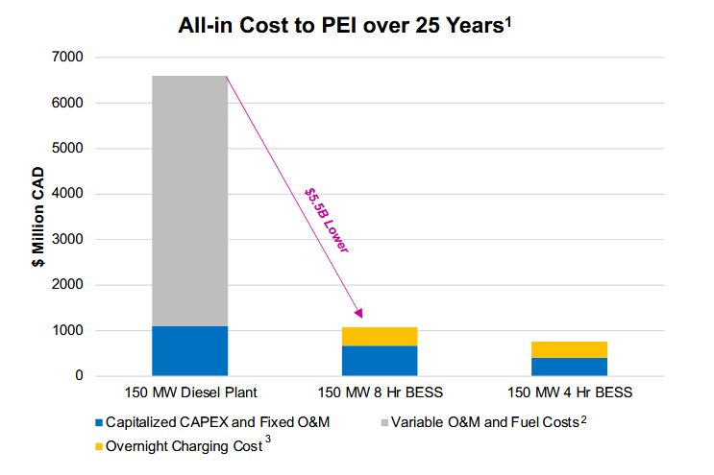
NRStor proposal in PEI – a very similar case to NB
Main difference from PEI to NB:
NB is a 500 MW proposal while PEI is a 150 MW proposal
All of the cost is burdened on ratepayers
Partial cost burdened on ratepayer, ratepayer relief with CIB, NRCan, and ITC’s!
NRStor Presentation to PEI Standing Committee on Natural Resources and Environmental Sustainability, January 26

Slide 15
Rushing things is more costly, we have options and time
NB Power’s Load growth assumptions are highly uncertain: New Brunswick’s projected load growth is the lowest in the region, and two-thirds of forecast growth is expected to be offset by demand-side resources.
Rushed decisions lock in higher costs: Fast-tracked projects limit competition, reduce transparency, and lead to long-term contracts that ratepayers must absorb for decades.
NB Power is publicly owned and should act like it: Decisions of this scale should reflect the will and long-term interests of New Brunswickers, not short-term procurement pressure.
Energy decisions should not be dictated by foreign fossil developers: Especially during a tariff and trade conflict with the U.S., New Brunswick should not lock itself into a long-term deal with an American pro-energy company.
Once signed, the costs are unavoidable: A 25-year contract leaves little flexibility if demand forecasts change, technologies improve, or cheaper solutions become available.
Alternatives were not adequately explored or compared: Demand response, energy efficiency, distributed renewables, storage, and phased solutions were dismissed quickly despite falling costs and faster deployment potential.
We have time to choose smarter, lower-cost options: A staged approach focused on efficiency, demand-side solutions, and non-fossil flexibility can address reliability needs without rushing into an expensive fossil lock-in.

Slide 16
What is CCNB Doing?
Research
Educate
Advocate
Activate
Collaborate
  Review EIA documents (comprehensive review?)
  Review NP Power documents
  Research technology
  Research alternatives
  Meetings/ workshops
  Media interviews
  Brochures/ Factsheets: Tantramar_Factsheet
  Letters and meetings with Ministers
  **Acting as an Intervener at EUB**
  Online letter-writing campaign
  Protect the Chignecto Isthmus Coalition
  Met and discussing alternatives with renewable and energy storage industry

Slide 17





A healthy, sustainable, just environment in New Brunswick for all.
How you can help!
Discover CCNB
Stay Informed
Become a Member
Become a Donor
Become an Advocate
www.conservationcouncil.ca
www.conservationcouncil.ca/econews/registration/
www.conservationcouncil.ca/join-ccnb/
www.conservationcouncil.ca/donate-ccnb/
www.conservationcouncil.ca/send-your-stopspraying-letter/

Slide 18

Thank you!

